Slide 1

Natural Language Processing and Data Augmentation for Question-Answering
Litt Lab 8/19/20
Micah Weitzman
Kevin Xie

Slide 2
Objective
Extract seizure frequency from medical notes
Allow clinicians to easily view critical information
Why use machine learning?
Manual verification from physicians is expensive and laborious
Question: What is the seizure frequency of patient #12456?
Answer: 2 per week

Slide 3
Datasets
SQuAD v1.1 (Rajpurkar et al., 2016)
Stanford Question Answering Dataset
88,000 Question-Answer Pairs
emrQA (Pampari et al., 2018)
QA for clinical notes
400,000+ Question-Answer Pairs
Penn medical notes
Seizure frequency dataset
~370 physician verified clinical notes

Slide 4
SQuAD v1.1 (Rajpurkar et al., 2016)
{"data": [
{
"title": "University_of_Notre_Dame",
"paragraphs": [
{
"context": "Architecturally, the school has a Catholic character…",
"qas": [
{
"answers": [
{"answer_start": 188,
"text": "a copper statue of Christ"}],
"question": "What is in front of the Notre Dame Main Building?",
"id": "5733be284776f4190066117f"
}
]}]}]}

Slide 5

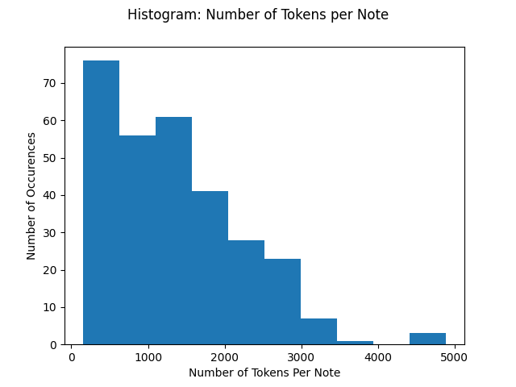
Models and Challenges
HuggingFace Transformers (Wolf et al., 2019)
BERT (Devlin et al., 2018)
Bidirectional Encoder Representations from Transformers
Contextual relationships between tokens
Masked Language Model (MLM)
Next Sentence Prediction (NSP)
BioBERT (Lee et al., 2020)
Domain specific for medical terminology
clinical BERT (Alsentzer et al., 2019)
Outperforms on non de-ID tasks
Long tokenized length
Restricts the usable models (BERT max = 512)
Data loss due to truncation
Longformer (Beltagy et al., 2020)
Attention O(n) instead of O(n²) -> max token length 4,096
EmrQA context token length
Notes:
_{Long-Document Transformer}

Slide 6
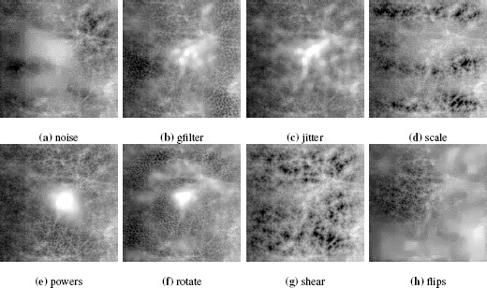
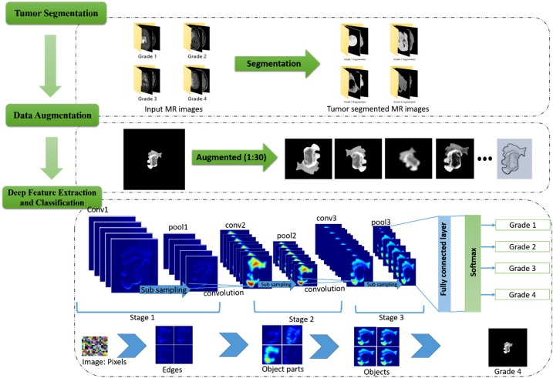
Data Augmentation in Imaging
Hussain et al., 2018
Sajjad et al., 2019

Slide 7
Data Augmentation Q-A Methods
Backtranslations (Yu et al., 2018) (Longpre et al., 2019)
Easy Data Augmentation (Wei et al., 2019)
Delete, replace, insert, swap
English
German
English

Slide 8
Backtranslation (Yu et al., 2018) (Longpre et al., 2019)
Translate the context/paragraph
Do not translate the questions (preserve the meaning of the questions)
Do not translate the answers (perform answer searching instead)
Answer searching
Exact Match: Find where an exact match of the original answer is inside the backtranslated context. If multiple, pick the answer at the index closest to the original index
Search heuristic: Use the first and last word of the original answer as the bounds for the answer’s “sentence”. Find possible spans inside the backtranslated context that fit this bound. Maximize the Jaccard similarity between the character-level bigram of the original answer to the bounds of the possible answer.
Else: If no exact match or spans are found, question answer pair is dropped

Slide 9
Backtranslation Example
Original
The emergence of resistance of bacteria to antibiotics is a common phenomenon. Emergence of resistance…
German
Das Auftreten von Resistenzen von Bakterien gegen Antibiotika ist ein häufig auftretendes Phänomen. Das Auftreten…
Backtranslation
The occurrence of resistances of bacteria to antibiotics is a common phenomenon. The occurrence of resistances…

Slide 10
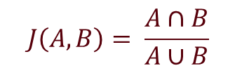
Backtrans - Search Heuristic Example
Original Question: “What is a modern common occurence with antibiotics?”
Original Answer: “Resistance of Bacteria”
bigram of original answer: ['re', 'es', 'si', 'is', 'st', 'ta', 'an', 'nc', 'ce', 'e ', ' o', 'of', 'f ', ' b', 'ba', 'ac', 'ct', 'te', 'er', 'ri', 'ia']
Bigram Answer:
Bounds [“Resistance”, “Bacteria”]
Possible index spans in context [(18, 41), (99, 240), (584, 772), (843, 870)]
Sample Bigram: ['re', 'es', 'si', 'is', 'st', 'ta', 'an', 'nc', 'ce', 'es', 's ', ' o', 'of', 'f ', ' b', 'ba', 'ac', 'ct', 'te', 'er', 'ri', 'ia’]
Jaccard Similarities: [0.91, 0.21, 0.14, 0.84]
Span of Best Bigram: (18, 41)
Final Answer: “resistances of bacteria”
$$J\left(A, B\right)= \frac{A∩B}{A∪B}$$
https://en.wikipedia.org/wiki/Jaccard_index

Slide 11
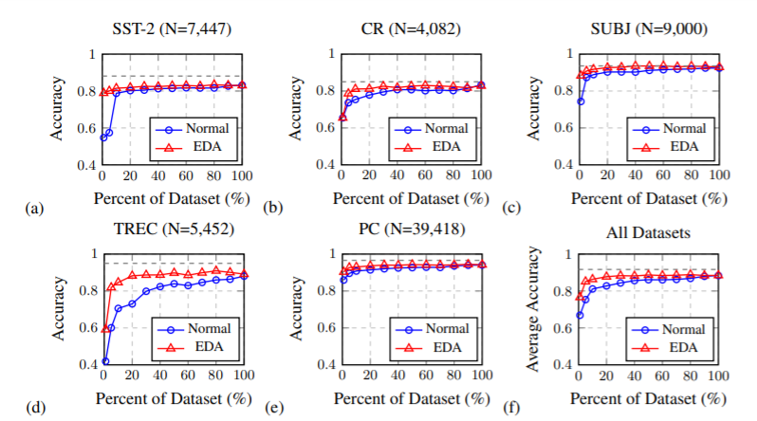
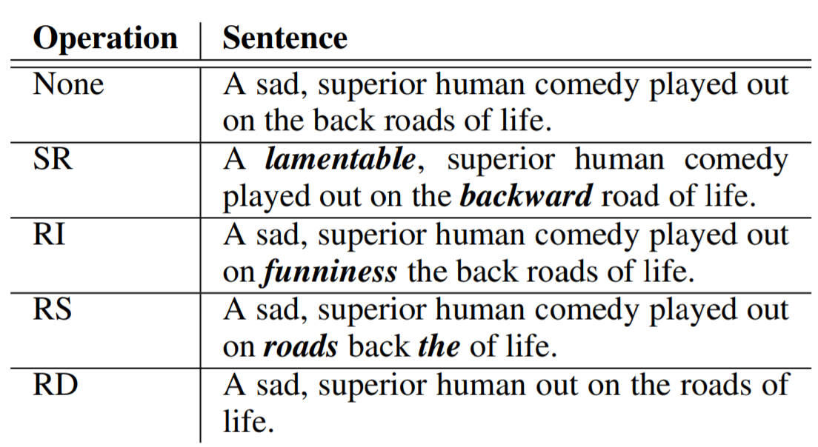
Easy Data Augmentation (Wei et al., 2019)
Easy Data Augmentation (EDA)
Synonym Replacement
Random Insertion
Random Swap
Random Deletion
~9 augmentations
eda.py
Figure 1: Performance on benchmark text classification tasks with and without EDA, for various dataset sizes used for training. For reference, the dotted grey line indicates best performances from Kim (2014) for SST-2, CR, SUBJ, and TREC, and Ganapathibhotla (2008) for PC.

Slide 12
eda.py (Wei et al., 2019)
"text": "a copper statue of Christ"
eda.py
{"a copper statue of savior",
"a copper statue pig of christ",
"a copper statue of messiah",
"a of statue copper christ",
"a cop statue of christ",
"a copper christ of statue",
"a copper statue of jesus of nazareth",
"good shepherd a copper statue of christ"}
Randomly select 1 response and propagate augmented answer back into “context”

Slide 13
EDA Workflow
Augment using eda.py
aug_squad_n_A.json
Train on GCP using
bert-base-uncased
Hugging Face
Combine augmented data
Randomly select n percent of SQuAD
aug_squad_n_B.json
aug_sqad_n_all.json
bert-base-uncased
aug_squad_n_C.json
aug_squad_n_D.json

Slide 14
Results

Slide 15
Challenges and Further Research
Unicode (utf-8)
Problems with implementation of EDA
Augmentation of contexts
Experiment with other models (Albert, RoBERTa, clinical BERT, bioBERT, Longformer, etc.)
Backtranslations bigram similarity threshold
Run model on patient data
Cross validation
Finetune to extract seizure frequency
Experiment on much smaller datasets
Notes:
Yu 2019 used a threshold for the similarity metric between answer bigrams. If no possible answer's similarity exceeded that threshold, they threw that example out. I didn't use a threshold because I have no basis yet for what constitutes a "good answer", but I plan to use one in the future

Slide 16
Thank You!
Kevin Xie – mentor
Dr. Brain Litt and the Litt Lab

Slide 17
Sources
Alsentzer, Emily, et al. "Publicly available clinical BERT embeddings." arXiv preprint arXiv:1904.03323 (2019).
Devlin, Jacob, et al. "BERT: Pre-training of Deep Bidirectional Transformers for Language Understanding". CoRR abs/1810.04805. (2018).
Beltagy, Iz, Matthew E. Peters, and Arman Cohan. "Longformer: The long-document transformer." arXiv preprint arXiv:2004.05150 (2020).
Hussain, Zeshan et al. “Differential Data Augmentation Techniques for Medical Imaging Classification Tasks.” AMIA ... Annual Symposium proceedings. AMIA Symposium vol. 2017 979-984. 16 Apr. 2018
Lee, Jinhyuk, et al. "BioBERT: a pre-trained biomedical language representation model for biomedical text mining." Bioinformatics 36.4 (2020): 1234-1240.
Longpre, Shayne, et al. "An Exploration of Data Augmentation and Sampling Techniques for Domain-Agnostic Question Answering.” arXiv preprint arXiv::1912.02145. (2019).
Pampari, Anusri, et al. "emrqa: A large corpus for question answering on electronic medical records." arXiv preprint arXiv:1809.00732 (2018).
Rajpurkar, Pranav, et al. "Squad: 100,000+ questions for machine comprehension of text." arXiv preprint arXiv:1606.05250 (2016).
Sajjad, Muhammad, et al. “Multi-Grade Brain Tumor Classification Using Deep CNN with Extensive Data Augmentation.” Journal of Computational Science, vol. 30, 2019, pp. 174–182., doi:10.1016/j.jocs.2018.12.003.
Wei, Jason, et al. "EDA: Easy Data Augmentation Techniques for Boosting Performance on Text Classification Tasks." arXiv preprint arXiv:1901.11196. (2019).
Wolf, Thomas et al. "HuggingFace's Transformers: State-of-the-art Natural Language Processing". ArXiv abs/1910.03771. (2019).
Yu, Adams Wei, et al. "QANet: Combining Local Convolution with Global Self-Attention for Reading Comprehension.“ arXiv preprint arXiv:1804.09541. (2018).

Slide 18
run_squad.py (Hugging Face)
python transformers/examples/question-answering/run_squad.py
--model_type bert
--model_name_or_path bert-base-uncased
--do_train
--do_eval
--train_file aug_squad_0.4_all.json
--predict_file dev-v1.1.json
--per_gpu_train_batch_size 12
--learning_rate 3e-5
--num_train_epochs 2.0
--doc_stride 128
--output_dir SQUAD_OUTPUT
--save_steps 10000

Slide 19
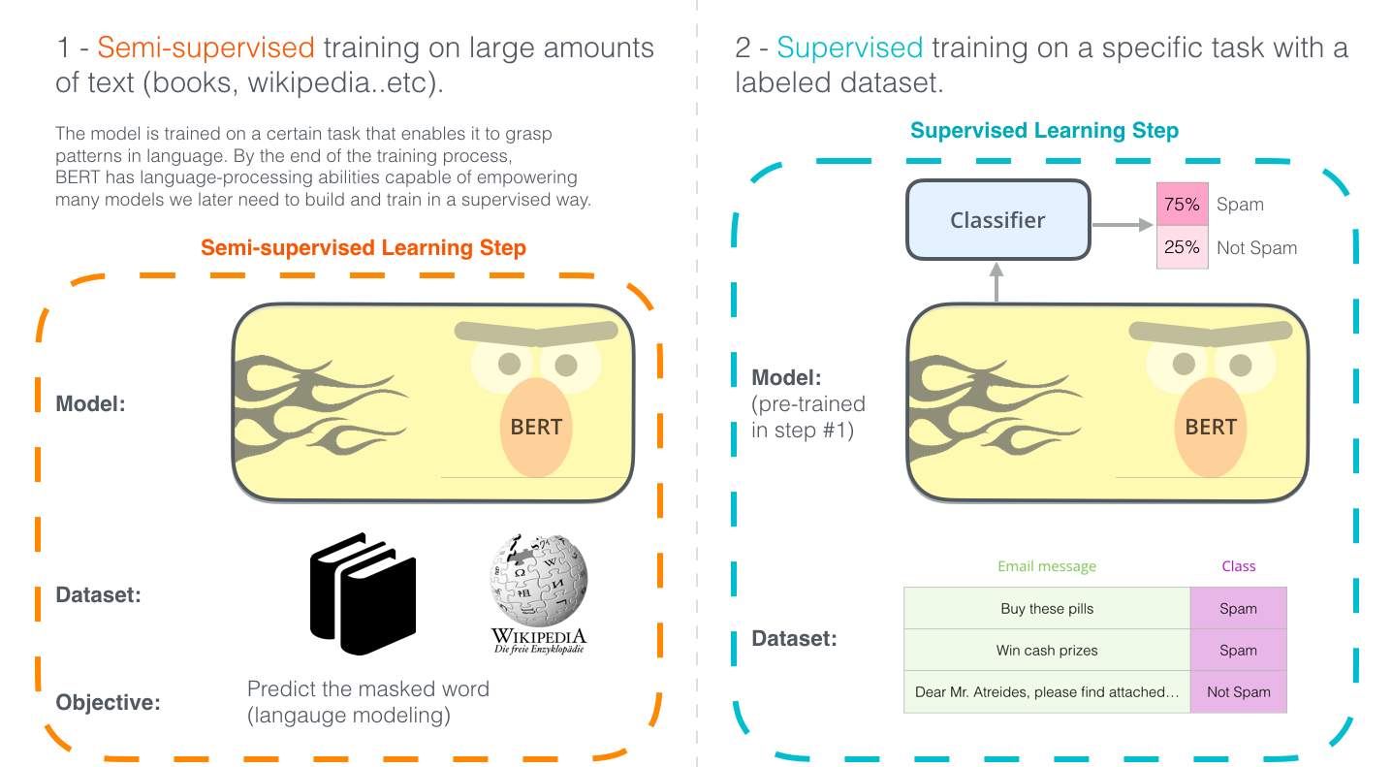
BERT
https://jalammar.github.io/illustrated-bert/

Slide 20
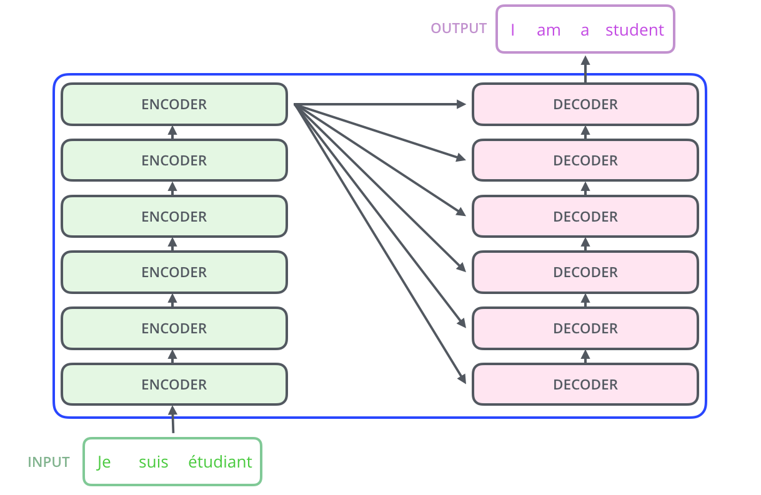
Transformers
Use attention to boost speed
https://jalammar.github.io/illustrated-transformer/

Slide 21
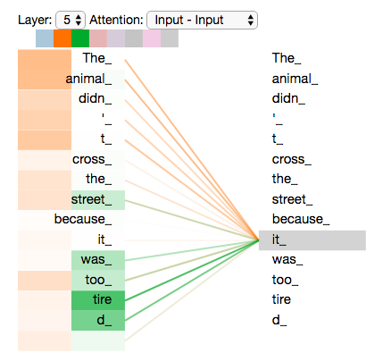
Transformers (con’t)
https://jalammar.github.io/illustrated-transformer/

Slide 22
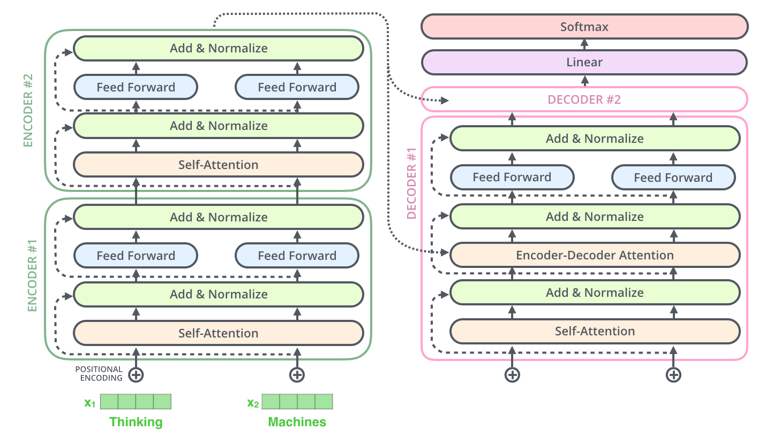
Transformers (con’t)
https://jalammar.github.io/illustrated-transformer/

